Slide 1


OUR LEGACY
MODULE ONE
Classified - Confidential

Slide 2

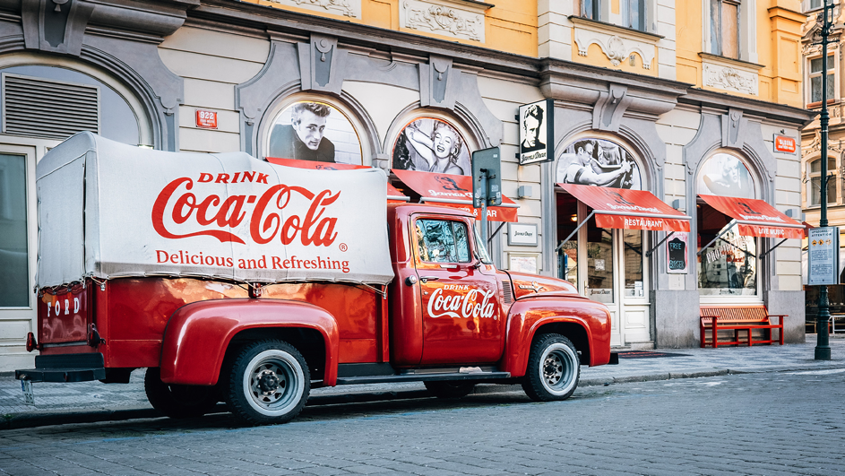
THE #1 BRAND IN THE WORLD: 135+ YEARS OF HISTORY
Coca-Cola is a cultural icon of continued relevance with over 135 years of history as the most recognized trademark in the world—always within an arm’s reach of desire. From beloved classics to bold innovations, we deliver drinks people crave.
Classified - Confidential

Slide 3
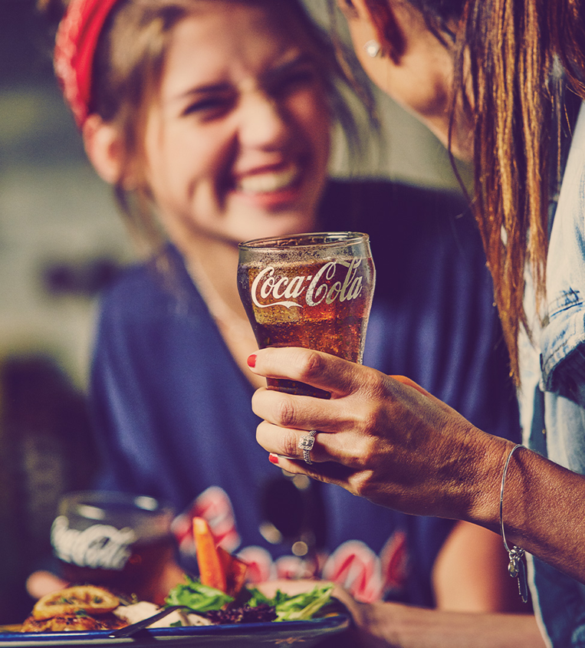
THE #1 FSOP PARTNER: A TOTAL BEVERAGE COMPANY
Foodservice + On Premise stands as a pillar of our legacy. We’re the heritage unit of Coca-Cola, born in a single fountain in 1886 at Jacob’s Pharmacy. We’re a cornerstone of the market. 3 out of 4 restaurants pour Coca-Cola and nearly half of consumers have their first Coke right in foodservice.
Classified - Confidential

Slide 4
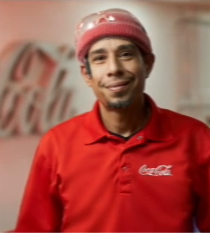
THE #1 THOUGHT LEADER: GROWING TOGETHER
We’re more than a force—we’re a force-multiplier. And our greatest power is our people. Leading with collaboration, we’re an extension our customers’ business with a future-focused determination to uncover growth opportunities by sharing our best-in-class network of experts, partners, and proprietary insights.
FPO
Classified - Confidential

Slide 5




BEVERAGES FOR LIFE
Loved brands, done sustainably, for a better shared future.
Our vision is to craft the brands and choice of drinks that people love, to refresh them
in body and spirit. And done in ways that create a more sustainable business and better shared future that makes a difference in people’s lives, communities and our planet.
A PORTFOLIO FOR
LOVED BRANDS
DONE SUSTAINABLY
FOR A BETTER SHARED FUURE
Everyone,
Every Occasion,
Every Daypart
We craft meaningful brands and a choice of drinks that people love and that refresh them in body and spirit
We use our leadership to be part of the solution to achieve positive change in the world and to build a more sustainable future for our planet
We invest to improve people’s lives, from our employees to all those who touch our business system, to our investors, to the broad communities we call home
Classified - Confidential

Slide 6
~200 MASTER BRANDS IN OUR PORTFOLIO
1,700+ FOODSERVICE & ON-PREMISE CUSTOMERS ACROSS 500K OUTLETS
OVER 30 BILLION-DOLLAR BRANDS
(GLOBALLY)
THE TOP CONSUMER BRAND
(GLOBALLY)
IN THE WORLD
(USA)
500 FSOP TEAM MEMBERS IN US
#1 IN CUSTOMER VALUE CREATION FOR 7 CONSECUTIVE YEARS
2.2 BILLION SERVINGS A DAY
68 BOTTLING PARTNERS
(GLOBALLY)
(USA)

Slide 7
~200 MASTER BRANDS IN OUR PORTFOLIO
1,700+ FOODSERVICE & ON-PREMISE CUSTOMERS ACROSS 500K OUTLETS
OVER 30 BILLION-DOLLAR BRANDS
(GLOBALLY)
THE TOP CONSUMER BRAND
(GLOBALLY)
IN THE WORLD
(USA)
500 FSOP TEAM MEMBERS IN US
#1 IN CUSTOMER VALUE CREATION FOR 7 CONSECUTIVE YEARS
2.2 BILLION SERVINGS A DAY
68 BOTTLING PARTNERS
(GLOBALLY)
(USA)

Slide 8
~200 MASTER BRANDS IN OUR PORTFOLIO
1,700+ FOODSERVICE & ON-PREMISE CUSTOMERS ACROSS 500K OUTLETS
OVER 30 BILLION-DOLLAR BRANDS
(GLOBALLY)
THE TOP CONSUMER BRAND
(GLOBALLY)
IN THE WORLD
(USA)
500 FSOP TEAM MEMBERS IN US
#1 IN CUSTOMER VALUE CREATION FOR 7 CONSECUTIVE YEARS
2.2 BILLION SERVINGS A DAY
68 BOTTLING PARTNERS
(GLOBALLY)
(USA)

Slide 10
~200 MASTER BRANDS IN OUR PORTFOLIO
1,700+ FOODSERVICE & ON-PREMISE CUSTOMERS ACROSS 500K OUTLETS
OVER 30 BILLION-DOLLAR BRANDS
(GLOBALLY)
THE TOP CONSUMER BRAND
(GLOBALLY)
IN THE WORLD
(USA)
500 FSOP TEAM MEMBERS IN US
#1 IN CUSTOMER VALUE CREATION FOR 7 CONSECUTIVE YEARS
2.2 BILLION SERVINGS A DAY
68 BOTTLING PARTNERS
(GLOBALLY)
(USA)

Slide 11
~200 MASTER BRANDS IN OUR PORTFOLIO
1,700+ FOODSERVICE & ON-PREMISE CUSTOMERS ACROSS 500K OUTLETS
OVER 30 BILLION-DOLLAR BRANDS
(GLOBALLY)
THE TOP CONSUMER BRAND
(GLOBALLY)
IN THE WORLD
(USA)
500 FSOP TEAM MEMBERS IN US
#1 IN CUSTOMER VALUE CREATION FOR 7 CONSECUTIVE YEARS
2.2 BILLION SERVINGS A DAY
68 BOTTLING PARTNERS
(GLOBALLY)
(USA)

Slide 12

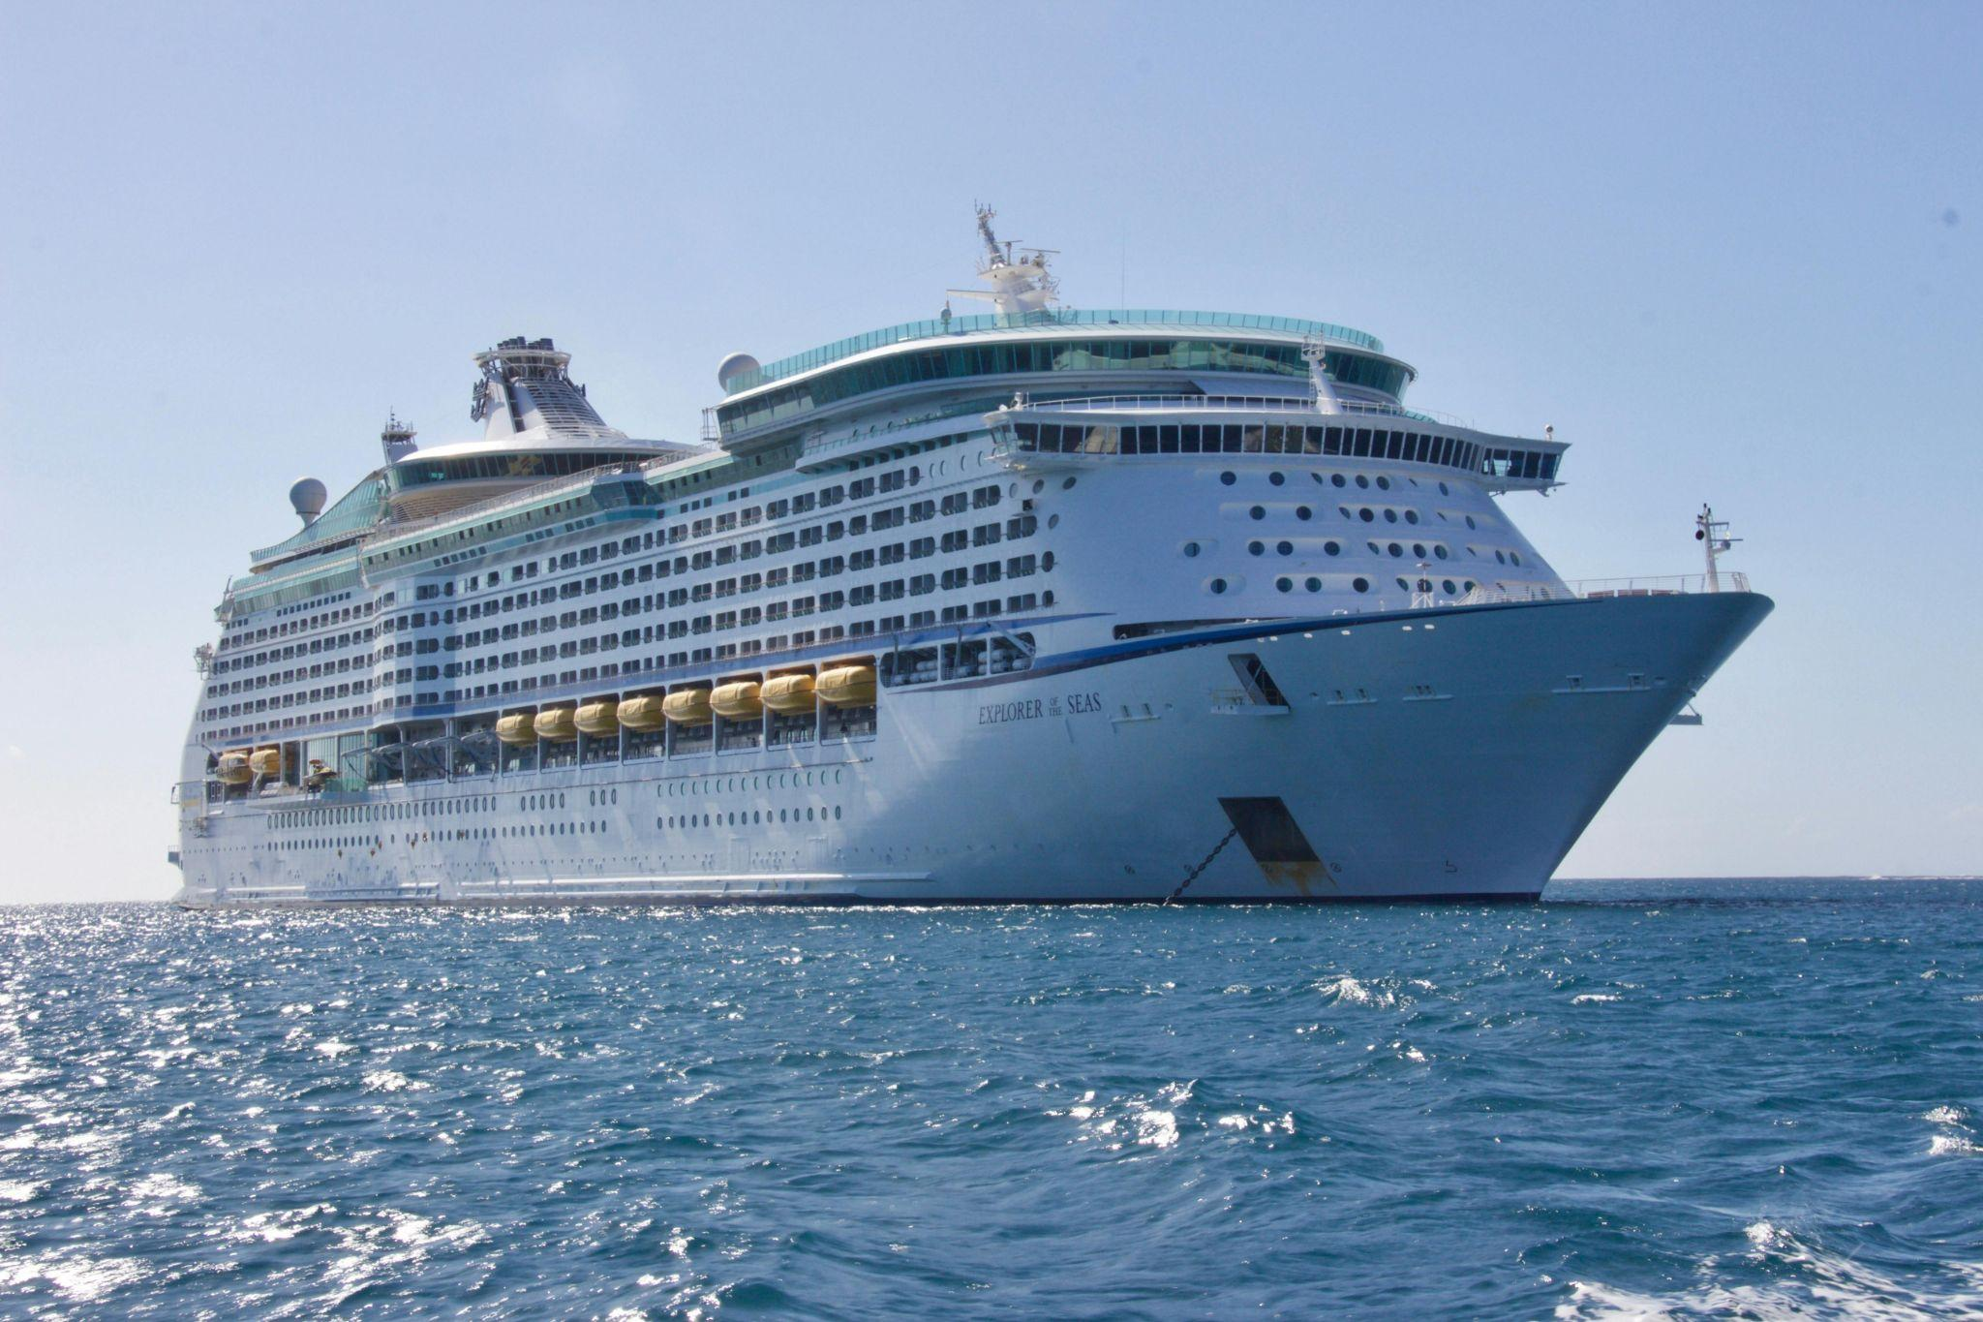
STRATEGIC NARRATIVE | APRIL 2025
Classified - Confidential

Slide 13


Slide 16
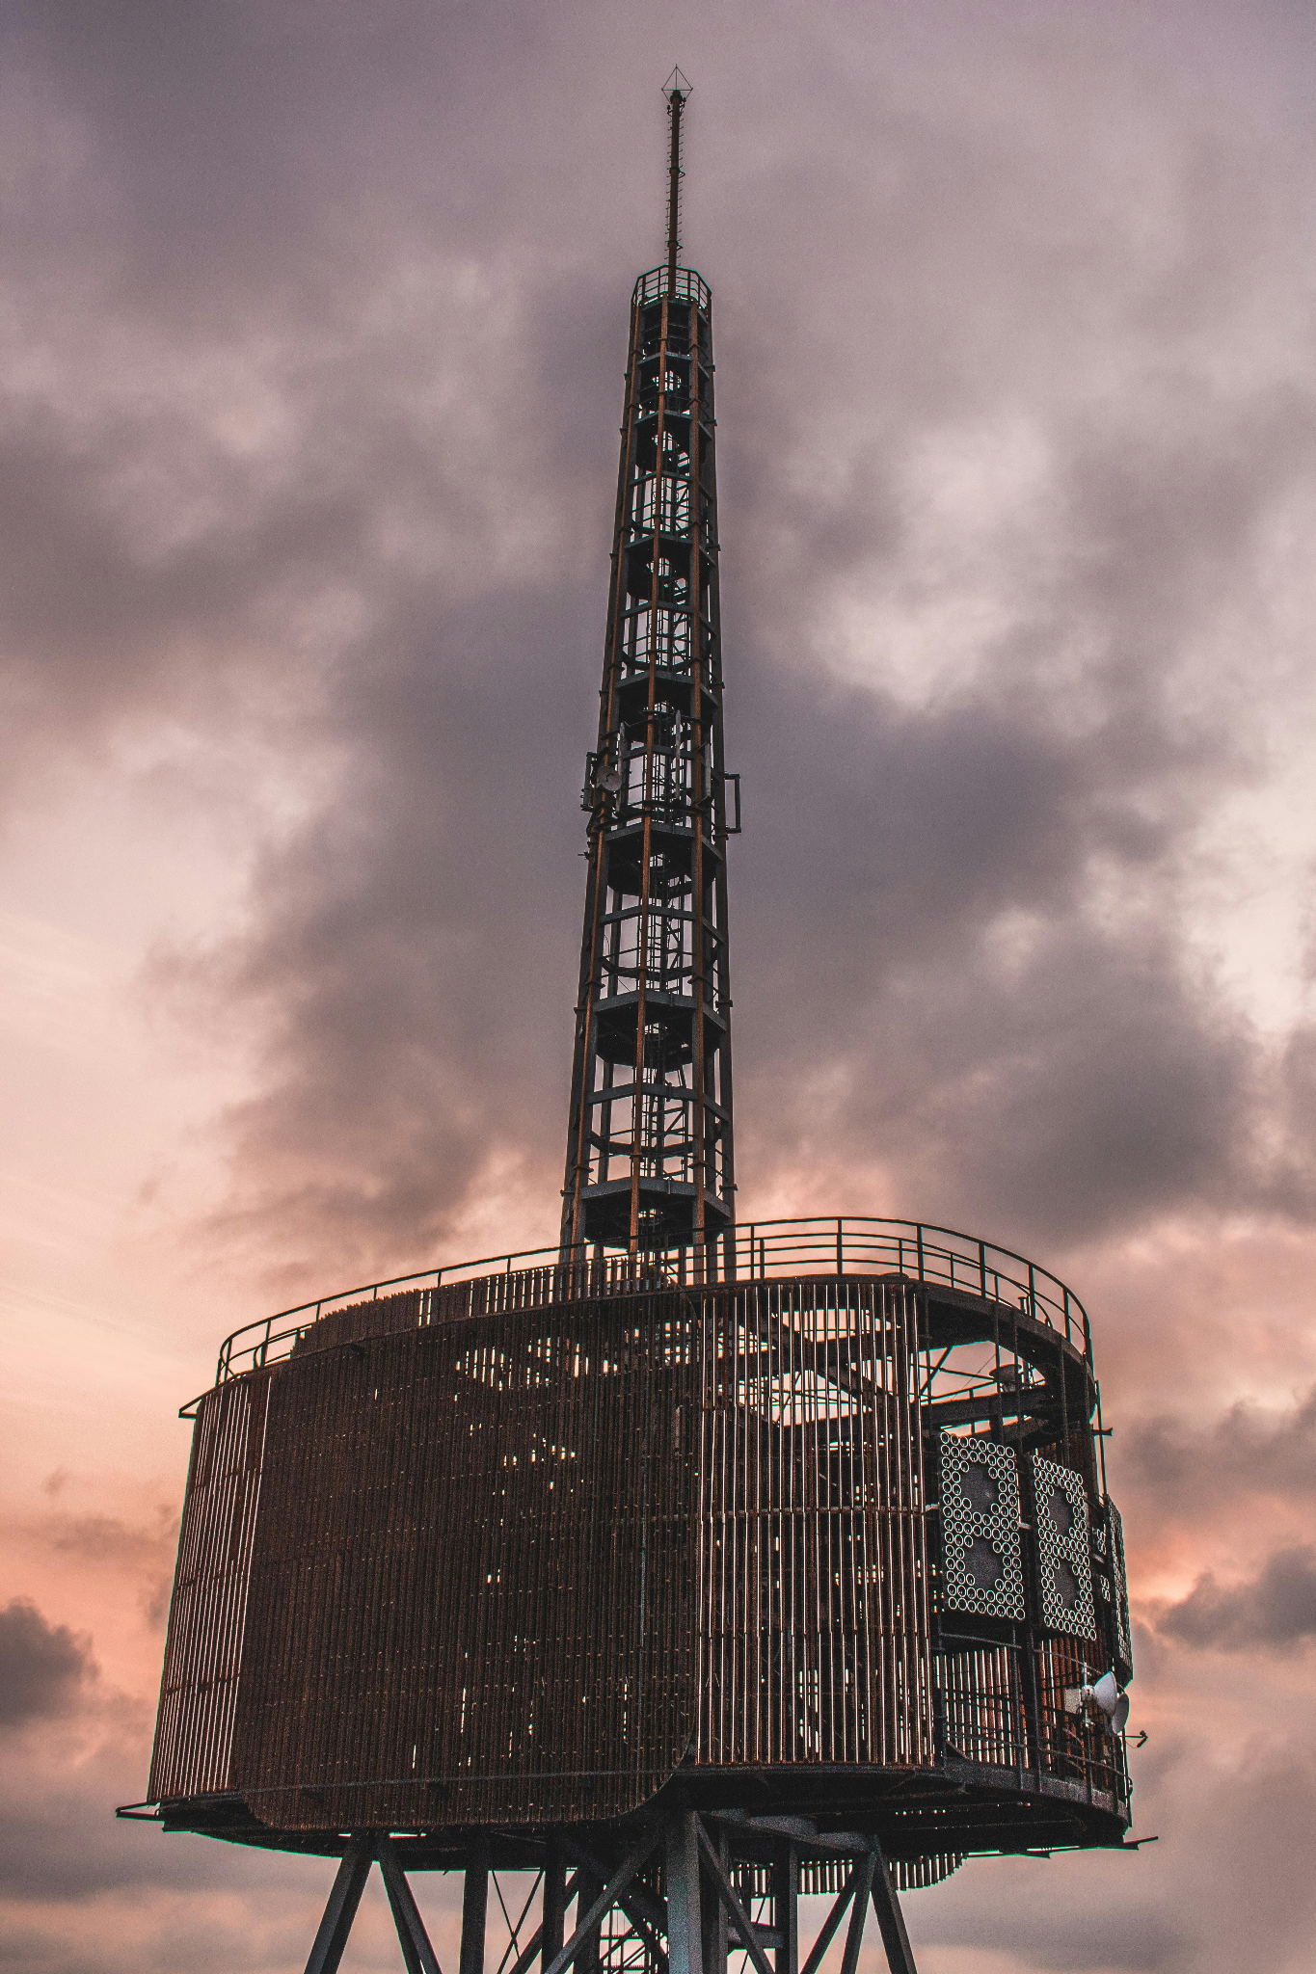
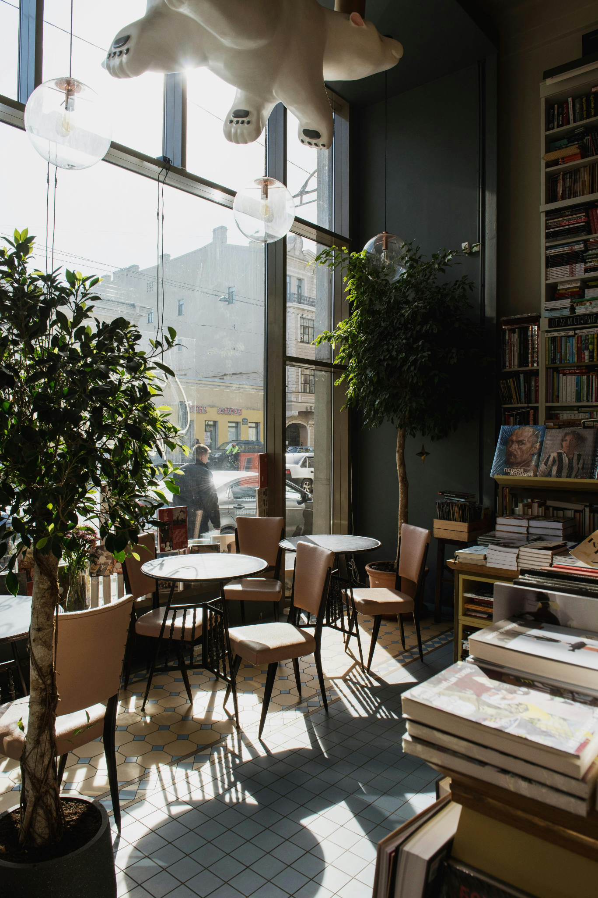


Slide 17
THANK YOU
Classified - Confidential

